Slide 1
Ai FAKE NEWS DETECTOR
CAPSTONE PROJECT
Presented By:
Student Name – Tejasvi Munjal
College Name- Dronacharya Government College
Department - Commerce

Slide 2
OUTLINE
Problem Statement (Should not include solution)
Proposed System/Solution
System Development Approach (Technology Used)
Algorithm & Deployment
Result
Conclusion
Future Scope
References

Slide 3
Problem Statement
.
Misinformation spreads rapidly through online news and social media.
Students find it difficult to differentiate between reliable and fake information.
There is a lack of accessible tools to quickly verify the credibility of digital content.

Slide 4
Proposed Solution
An AI solution that analyzes articles to assess their credibility.
Provides concise, trustworthy summaries to prevent the spread of false information.
A lightweight application that works both online and offline to accommodate students with limited resources.

Slide 5
System Approach
Language: Python (via Python.org).
Libraries:
    Scikit-Learn: For machine learning models (Supervised Learning).
    Pandas: For data handling and processing.
    User Interface: Streamlit for building a fast, interactive web app.

Slide 6
Algorithm & Deployment
Algorithm: Passive Aggressive Classifier.
Why : It is memory-efficient for 2GB RAM and supports "online learning".
Feature Extraction: TF-IDF Vectorizer to convert text into numerical data.
Deployment: The application is deployed using Streamlit or Gradio for easy access via a web browser.

Slide 7
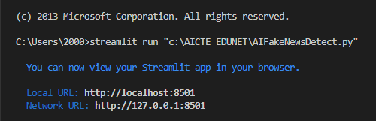
Result
Code Link: - https://github.com/tejasvimunjal17-source/AI-Fake-News-Detector/blob/main/AIFakeNewsDetect.py

Slide 8
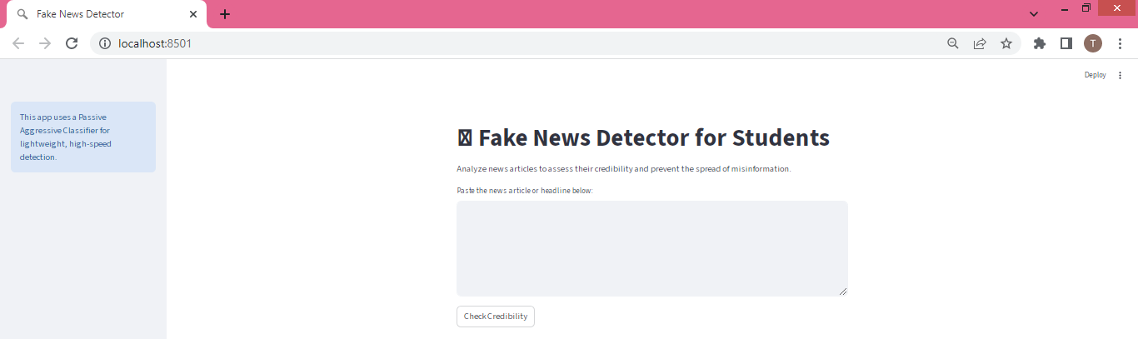
Result

Slide 9
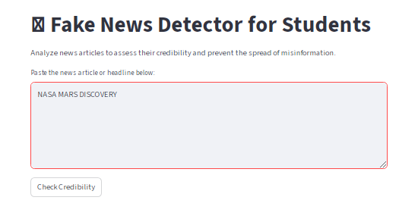
Result

Slide 10
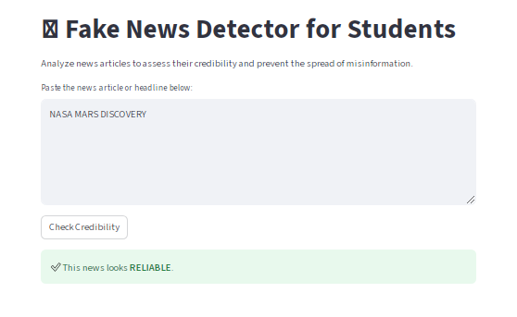
Result

Slide 11
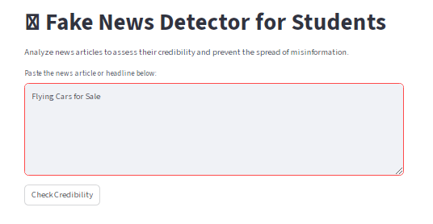
Result

Slide 12
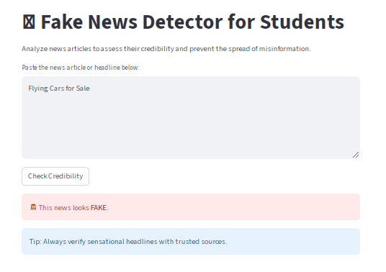
Result

Slide 13
Conclusion
The project provides a practical AI tool to combat digital misinformation.
By using lightweight machine learning, the tool remains accessible to students on older hardware.
It empowers students to become more critical consumers of online information.

Slide 14
Future scope
Integration with browser extensions to verify news in real-time.
Expanding the detector to support multiple regional languages.
Adding image and video deepfake detection capabilities.

Slide 15
References
Hugging Face – The AI community building the future.
Streamlit • A faster way to build and share data apps
Welcome to Python.org
1. Supervised learning — scikit-learn 1.8.0 documentation

Slide 16
Github link
Github Link : https://github.com/tejasvimunjal17-source/AI-Fake-News-Detector
Deployment Link: Streamlit or gradio links - https://github.com/tejasvimunjal17-source/AI-Fake-News-Detector/blob/main/AIFakeNewsDetect.py

Slide 17
THANK YOU

